Slide 1

NEUMATIC LEVITATOR
CONTROL
Sebastian Jaramillo Verdugo
Rosemberth Steeven Preciga Puentes
Jorge Santiago Camargo Guerrero
Gabriel Felipe Ostos Iguavita
ENGINEERING

Slide 2


TRANSFER FUNCTION
ALTERNATIVE MODEL
This model is easier to identify and captures the dynamics of the system in a more general way. The controller was developed based on this model.

Slide 3
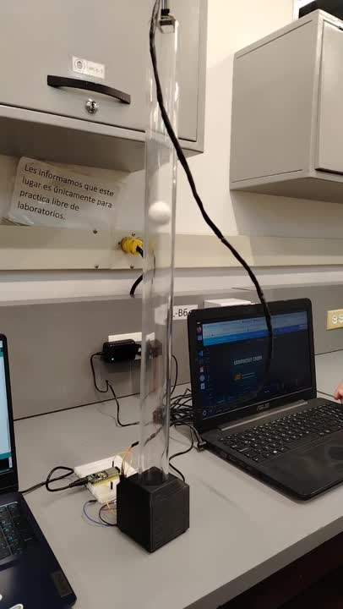
CRUDE ESTIMATION
Estimación de Ueq
SYSTEM LEVITATION EQUILIBRIUM VOLTAGE
Voltage value that slowly raises
the levitating object.
It is found using the voltsToFan(volts) function with
a fixed voltage value.

Slide 4
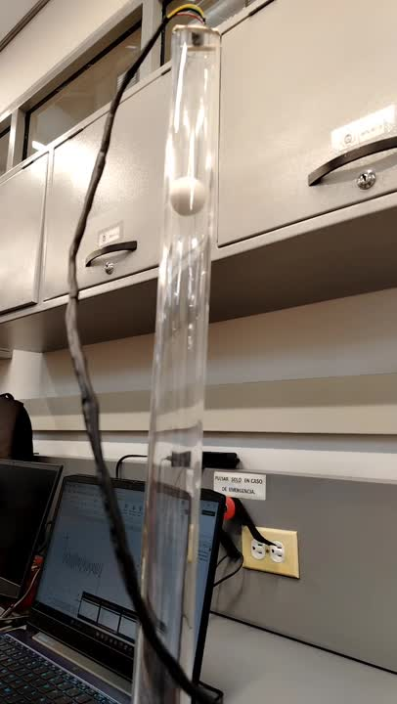

CLOSED-LOOP ESTIMATION
Exact value of Ueq
PROPORTIONAL CONTROL
The value of kp must be varied until the object stabilizes at a point.

Slide 5

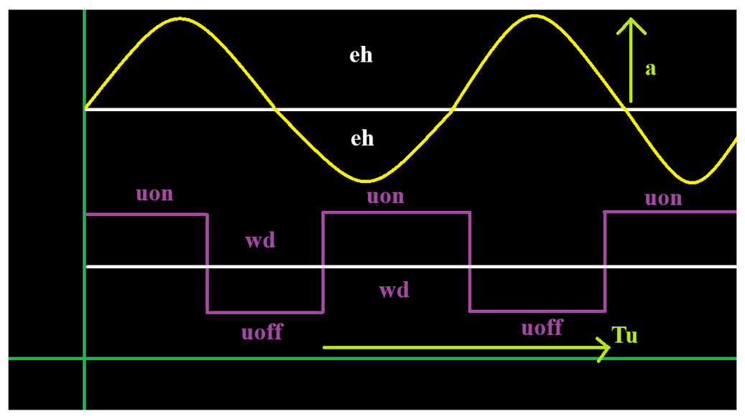
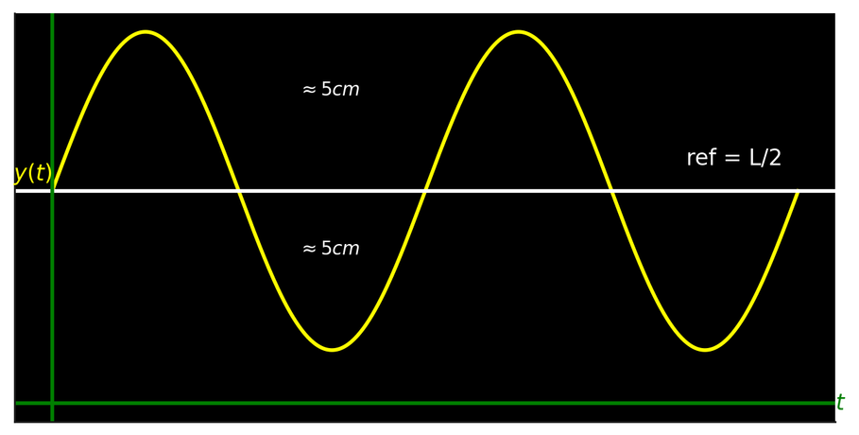
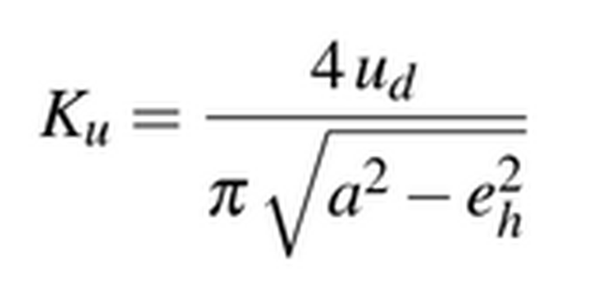
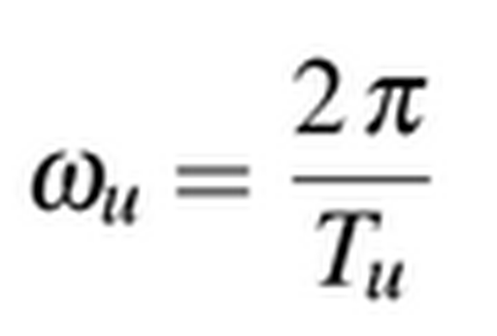

ÅSTROM RELAY EXPERIMENT
Éstimación de Ku y ωu
The object must perform a programmed oscillation using the hysteresis value and the change in the control signal.
There must be a total excursion of about 5 cm around the operating point.
Ultimate system gain
Last system frequency

Slide 6
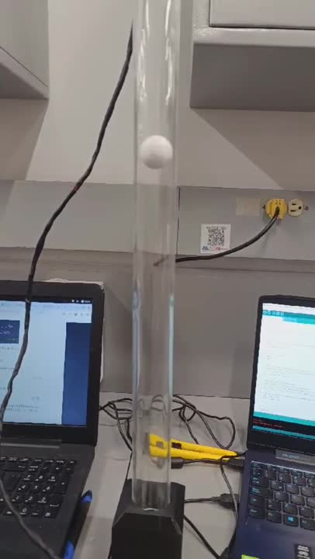
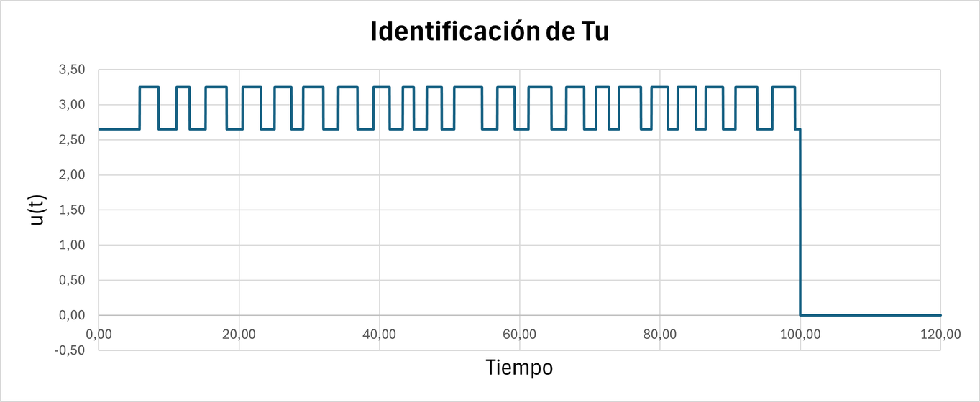
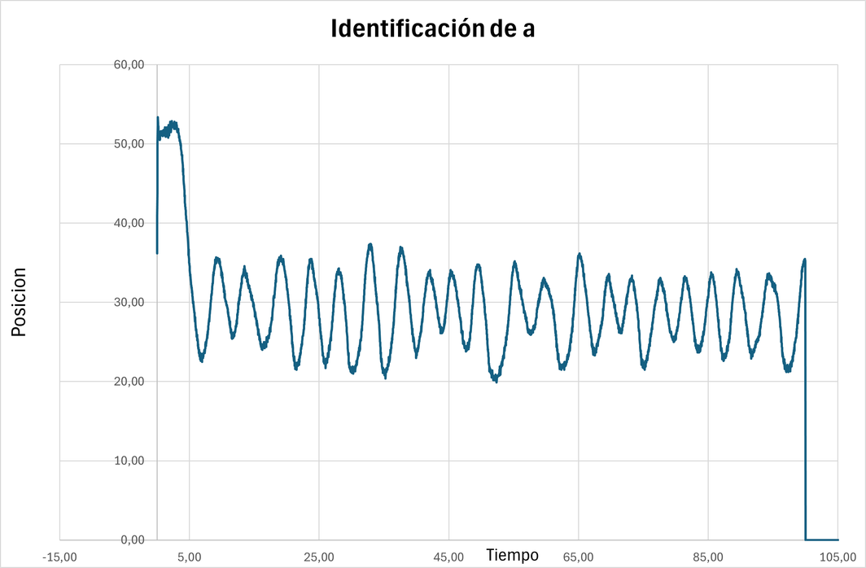
ÅSTROM RELAY EXPERIMENT
Éstimación de Ku y ωu
Ultimate system gain
ku = 0.07
Last system frequency
wu = 1.33

Slide 7

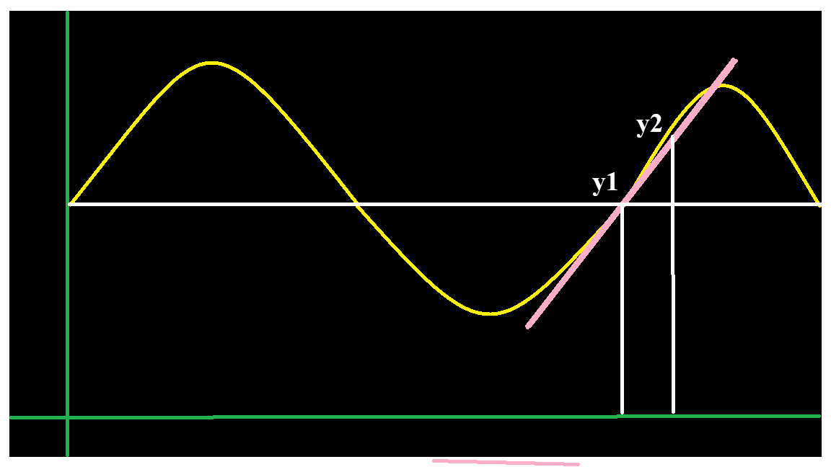
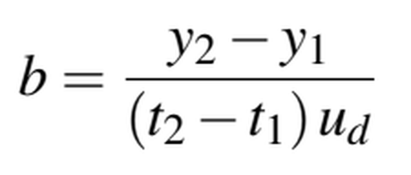
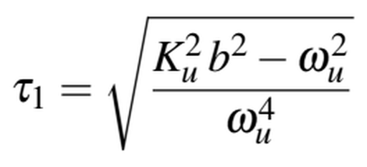
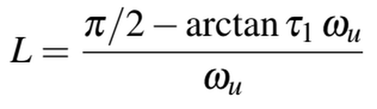
DETERMINACIÓN DE B, 𝜏, L
System gain
Time constant
System delay

Slide 8
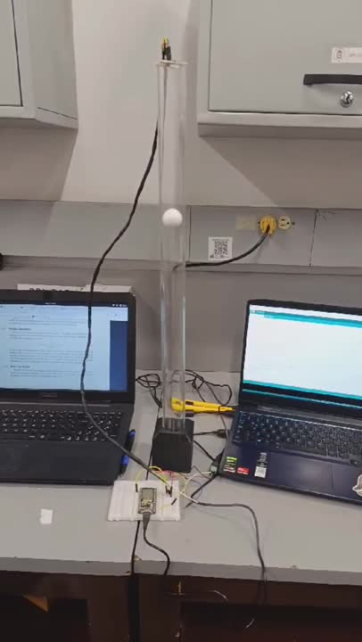
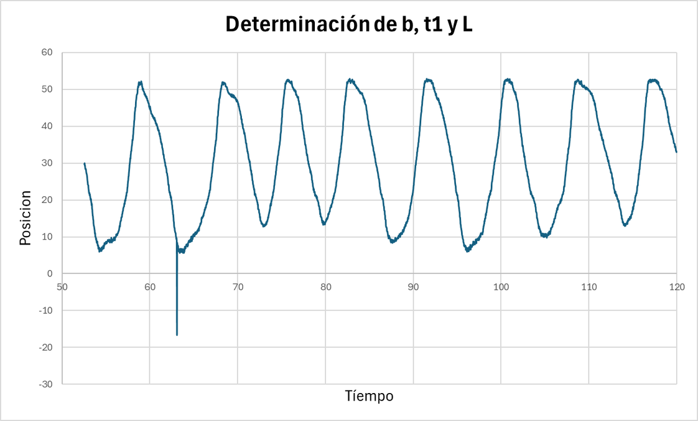
DETERMINATION OF B, 𝜏, L
System Gain
b = 53.3
Time constant
tau = 2.00039
System Dalay
L = 0.27

Slide 9

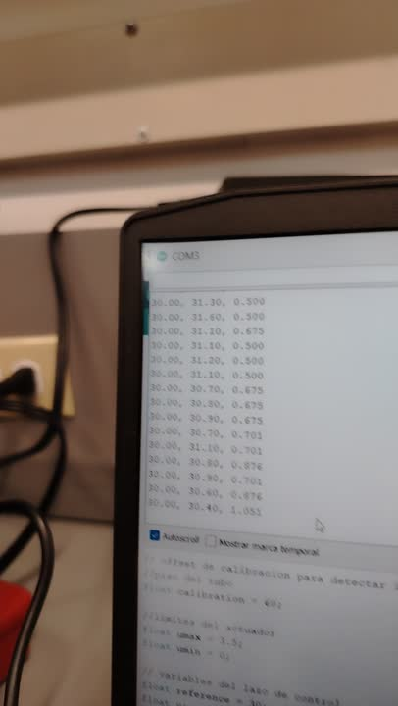
RESULTS
OBTAINED
METHOD
Two-degree-of-freedom PID controller
VALUES
N = 14
wn = 15
z = 1

Slide 10




THANKS
REFERENCIAS
K.J. Åström y T. Hägglund. Advanced PID Control. ISA-The Instrumentation, Systems, y Automation Society, 2006. ISBN: 9781556179426. URL: https://books.google.com.co/books?id=XcseAQAAIAAJ
Karl Johan Åström y Richard M. Murray. Feedback Systems: An Introduction for Scientists and Engineers. 2.a edición. Princeton University Press, 2021. ISBN:978-0-691-19398-4. URL: http://press.princeton.edu/
Control Tutorials for MATLAB y University of Michigan Simulink. Aircraft Pitch: System Modeling.
L. Bermeo Clavijo, “Levitador neumático: Modelo matemático y método ‘pragmático’ de identificación,”

